Slide 1

Web API Security
(API Version 2.0)
Implementing Security
in Web API 2.0
By Muthuraja Learn @ Lunch Time

Slide 2
LAB OUTLINE
Web API 2.0 Authentication Types
What is Authentication & Authorization ?
Ways to pass Identity/User Credentials
Why No Authentication ?
Understanding SOP & CORS
Implementing in-build & custom CORS policy
Understanding and implementing Security Pipeline
Implementing Windows Authentication
Local Account Authentication
Custom Authentication
Token Based Authentication (with ASP.NET Identity & Identity.Framework)
Refresh Token Based Authentication
By Muthuraja Learn @ Lunch Time

Slide 3
Web API 2.0 Authentication Types
No Authentication
For applications that don’t require any user authentication. If you select No Authentication, the application will contain no web pages for logging in, no UI indicating who is logged in, no entity classes for a membership database, and no connection string for a membership database.
Individual Authentication
For applications that store user profiles in a SQL Server database. If you select Individual User Accounts, the sample application will be configured to use ASP.NET Identity (formerly known as ASP.NET membership) for user authentication. ASP.NET Identity enables a user to register an account, by creating a username and password on the site or by signing in with social providers such as Facebook, Google, Microsoft Account, or Twitter.
Organizational Authentication
For applications that authenticate users with Active Directory, Windows Azure Active Directory, or Office 365. If you select Organizational Accounts, the sample application will be configured to use Windows Identity Foundation (WIF) for authentication based on user accounts in Azure Active Directory (Azure AD, which includes Office 365) or Windows Server Active Directory.
Windows Authentication
For applications (intranet) that wants basic/form windows authentication. This is a classic authentication. If you select Windows Authentication, the sample application will be configured to use the Windows Authentication IIS module for authentication.
By Muthuraja Learn @ Lunch Time

Slide 4
Authentication & Authorization
Authentication
It is the verification of the credentials of the connection attempt. This process consists of sending the credentials from the remote access client to the remote access server in an either plaintext or encrypted form by using an authentication protocol.
Authorization
This refers to rules that determine who is allowed to do what. Authorization occurs after successful authentication.
By Muthuraja Learn @ Lunch Time

Slide 5
Passing Credential
Ways to pass credentials to Web API
Header
Authentication: <schema> <token>
Ex: authentication: basic 8skls02003kemdm2-4l23ll2-9
Query String
? <key-value pair>
Ex: ?user=84k42d&pwd=ll340kj2
Client Certificate
Creating and adding CC on client machine
Read CC (X509Certificate2) thru Request.GetClientCertificate method
Cookies
Creating and sending cookie to client machine thru Response.Headers.AddCookies
Read Cookie thru Request.Headers.GetCookies method
By Muthuraja Learn @ Lunch Time

Slide 6
Lab: No Authentication
No Authentication
For applications that don’t require any user authentication. If you select No Authentication, the application will contain no web pages for logging in, no UI indicating who is logged in, no entity classes for a membership database, and no connection string for a membership database.
By Muthuraja Learn @ Lunch Time

Slide 7
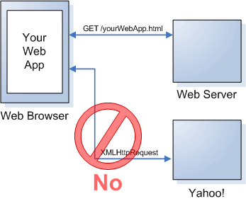
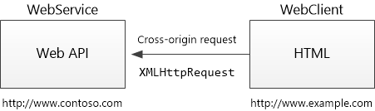
SOP and CORS
Same-origin policy (SOP)
In computing, the same-origin policy is an important concept in
the web application security model. Under the policy, a web
browser permits scripts contained in a first web page to access
data in a second web page, but only if both web pages have the
same origin. An origin is defined as a combination of URI Scheme,
hostname, and port number. This policy prevents a malicious
script on one page from obtaining access to sensitive data on
another web page through that page's DOM.
Cross Origin Resource Sharing (CORS)
Cross Origin Resource Sharing (CORS) is a W3C standard that
allows a server to relax the same-origin policy. Using CORS,
a server can explicitly allow some cross-origin requests while
rejecting others. CORS is safer and more flexible
By Muthuraja Learn @ Lunch Time

Slide 8

Implementing CORS
Enabling CORS in Web API 2.0
Add the CORS NuGet package. In Package Manager Console window, type the following command:
Install-Package Microsoft.AspNet.WebApi.Cors
You can enable CORS in the following way
Enable on specific Action(s)
Enable on specific Controller(s)
Add code to the WebApiConfig.Register method.
Add EnableCors attribute to controller as
Globally enable CORS for all controller(s) & action(s)
Disabling CORS
To disable CORS for an action, add the [DisableCors] attribute to the action. The following example enables CORS for every method except PutItem.
By Muthuraja Learn @ Lunch Time

Slide 9
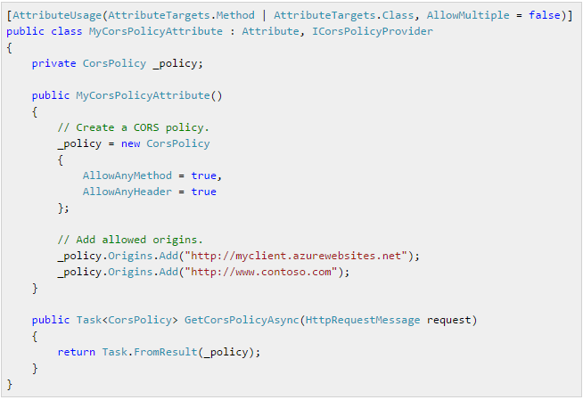

Custom CORS Policy Attribute
Custom CORS Policy Providers
1. The [EnableCors] attribute implements the ICorsPolicyProvider interface. You can provide your own implementation by creating a class that derives from Attribute and implements ICorsProlicyProvider.
2. Now you can apply the attribute any place that you would put [EnableCors].
Custom CORS Policy Providers Factory
NOTE: For example, a custom CORS policy provider could read the settings from a configuration file. Also as an alternative to using attributes, you can register an ICorsPolicyProviderFactory object that creates ICorsPolicyProvider objects using HttpConfiguration.SetCorsPolicyProviderFactory class.
By Muthuraja Learn @ Lunch Time

Slide 10
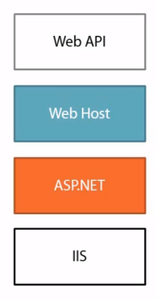
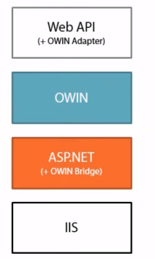
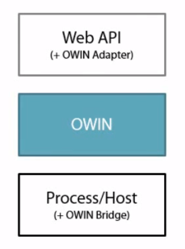
Implementing Security Pipeline in Web API 2.0
Classic Hosting
OWIN Hosting on IIS
Pure OWIN Hosting
By Muthuraja Learn @ Lunch Time

Slide 11





Implementing Security Pipeline in Web API 2.0
Classic Hosting
OWIN Hosting on IIS
OWIN Self Hosting
Default.html
api/test
File/Service on Server Side
OWIN Middleware
OWIN Middleware
&
OWIN Self Host
Hosting
HTTP Handler
Request
HTTP Module
Response
ASP.NET HTTP Runtime (aspnet_isapi)
ASP.NET Runtime
IIS (Internet Information Server)
IIS
Default.html
api/test
Client
By Muthuraja Learn @ Lunch Time

Slide 12
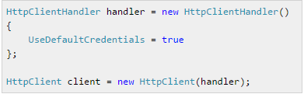

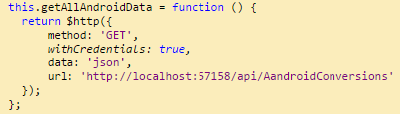

Implementing Windows Authentication in Web API 2.0
Windows Authentication
Integrated Windows authentication enables users to log in with their Windows credentials, using Kerberos or NTLM. The client sends credentials in the Authorization header. Windows authentication is best suited for an intranet environment.
Advantages | Disadvantages
Built into IIS. Does not send the user credentials in the request. If the client computer belongs to the domain (for example, intranet application), the user does not need to enter credentials. | Not recommended for Internet applications. Requires NTLM support in the client. Client must be in the Active Directory domain.
To enable Windows Authentication in application :
Http Client call with Windows Credential
(1) web.config
Angular JS call with Windows Credential
(2) Project property
By Muthuraja Learn @ Lunch Time

Slide 13
Any question ?
By Muthuraja Learn @ Lunch Time

Slide 14
Thank You
By Muthuraja Learn @ Lunch Time

